Slide 1
Sketch-Based Image Retrieval
Ahmad Alsaleh 93749
Yousef Irshaid 93447
Omar Safwat 93225

Slide 2
Introduction
• Problem Perspective:
Difficulty in retrieving images when precise terminology or full-image queries are unavailable.
• Challenge:
Bridging the domain gap between abstract sketches and detailed real-world images.

Slide 3
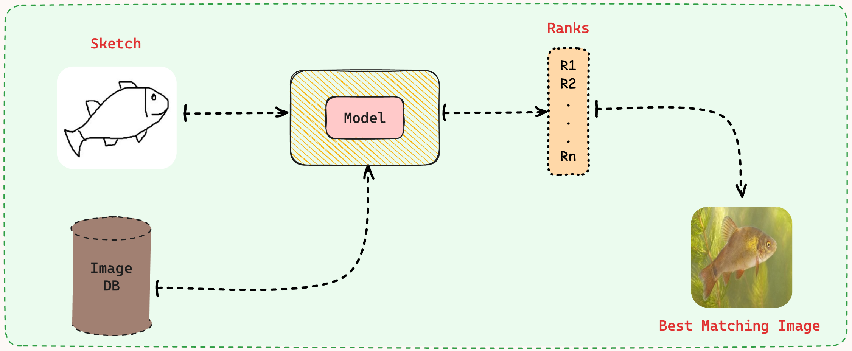
Problem Statement
Bridging the domain gap between abstract sketches and detailed real-world images to enable accurate and semantic-driven image retrieval.

Slide 4
Literature Review
Doodle to Search: Practical Zero-Shot Sketch-based Image Retrieval [1]
Generative Domain-Migration Hashing for Sketch-to-Image Retrieval [2]
Sketch-Guided Object Localization in Natural Images [3]

Slide 5
Literature Review
• ZSSBIR with QuickDraw-Extended: Introduces Zero-Shot SBIR using a cross-domain embedding model with novel loss functions (Triplet, Domain, and Semantic Loss) to align sketches and images. Features the QuickDraw-Extended dataset for realistic sketch modeling, achieving state-of-the-art performance in multiple datasets.
• GAN-Based Domain Bridging: Utilizes GANs for sketch-to-image transformations, ensuring semantic retention with cycle consistency. Incorporates a hashing network for efficient retrieval, improving performance by up to 26.4% in Sketchy and TU-Berlin datasets while reducing computational costs.
• Sketch-Guided Object Localization: Proposes a novel cross-modal attention mechanism for object localization within complex scenes. Employs a Region Proposal Network (RPN) guided by sketch-based similarity scores, achieving notable AP@50 results on the MS-COCO dataset for single and multi-query scenarios.

Slide 6
Literature Review
Paper | Focus | Key Contributions | Results
ZSSBIR with QuickDraw-Extended | Zero-Shot SBIR using cross-domain embedding model with novel loss functions. | Introduces QuickDraw-Extended dataset for realistic sketch modeling. Combines Triplet, Domain, and Semantic Loss for effective retrieval. | State-of-the-art performance on Sketchy-Extended and other datasets.
GAN-Based Domain Bridging | GANs for sketch-to-image transformation with semantic retention. | Cycle consistency ensures no information loss. Incorporates hashing network for fast retrieval. | Up to 26.4% improvement in Sketchy and TU-Berlin datasets with reduced memory and computation.
Sketch-Guided Object Localization | Locating objects in complex scenes using a hand-drawn sketch. | Cross-modal attention mechanism guides Region Proposal Network (RPN) for relevant object proposals. | AP@50 of 50.0% for single-query and up to 17.1% for multi-query on MS-COCO dataset.

Slide 7


Methodology
Data indigestion:
Clean unneeded images
Scale to 256x256 (224x224 for AlexNet)
Filter 12 common classes
Augmentation:
~3000 bad sketches vs ~600 good sketches for each class
Apply random horizontal flipping, and Affine transformation (rotation, scale, shear) for good sketches sketches
Deep Learning Model: Custom trained CycleGANs and AlexNet classifer
Performance metrics: Precision, Recall, F1 score, accuracy of the classifier network

Slide 8
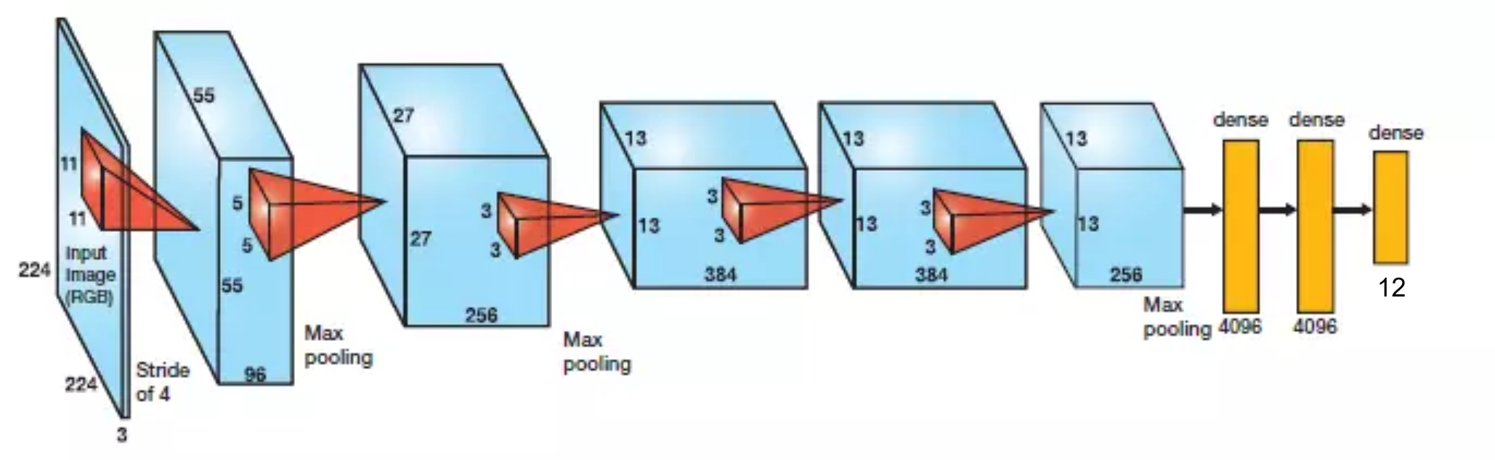
Implementation – AlexNet Classifier

Slide 9
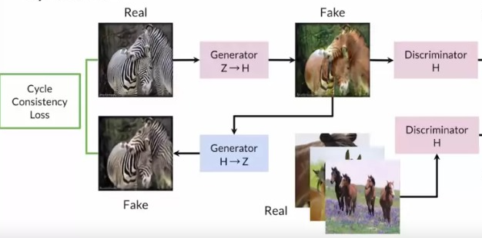
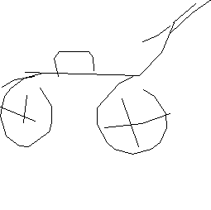
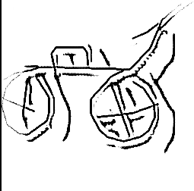
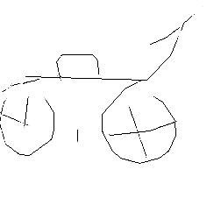
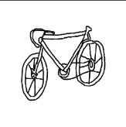
Implementation – CycleGAN

Slide 10
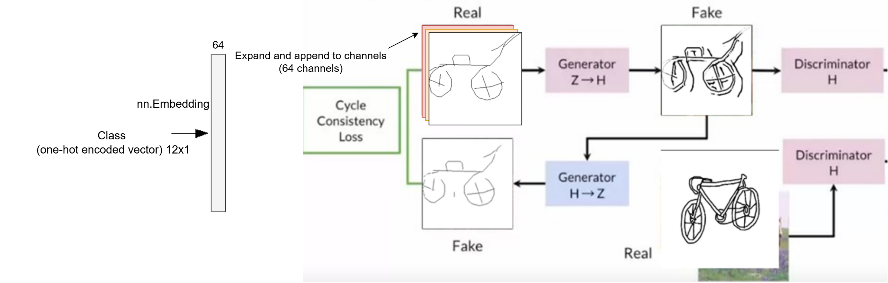
Conditional CycleGAN (StarGAN)
Infeasible to train a CycleGAN for each class

Slide 11
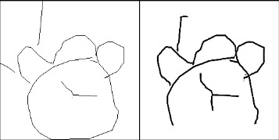
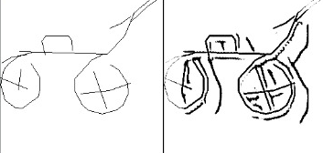
Results

Slide 12
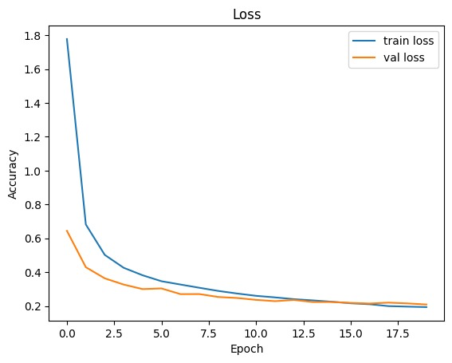
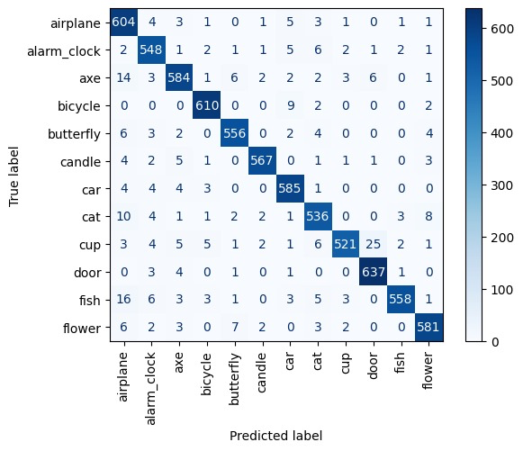
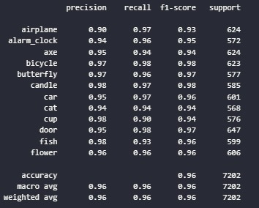
Performance evaluation – Classifier

Slide 13
Discussion
The GAN learns:
To draw specific distinct features in each class
E.g. Clock hands and bike frame
To increase visibility through thickening strokes
To give depth to objects
E.g. bike wheels
Future work: finetuning Stable Diffusion
Offers potential for better enhancements to sketches

Slide 14
Work Division
Training Models: All members
Data Indigestion & Augmentation: Yousef & Omar
Evaluation of Models: Ahmad

Slide 15
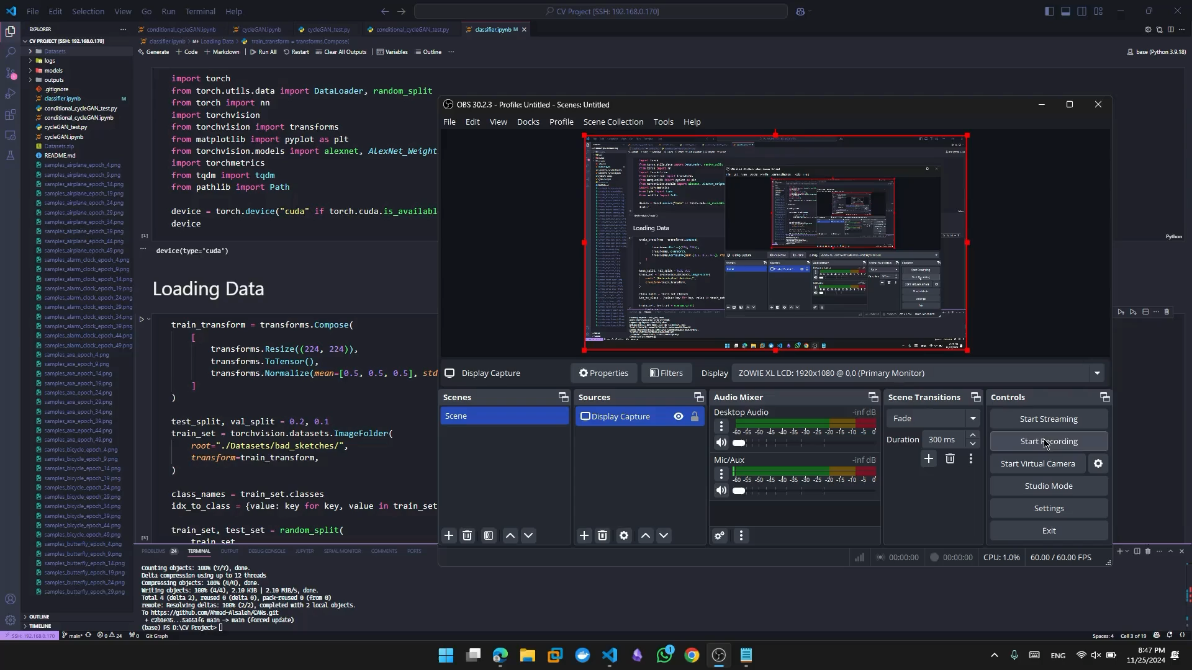
Demonstration

Slide 16
References
[1] S. Dey, P. Riba, A. Dutta, J. L. Llados, and Y.-Z. Song, “Doodle to search: Practical zero-shot sketch-based image retrieval,” 2019 IEEE/CVF Conference on Computer Vision and Pattern Recognition (CVPR), Jun. 2019, doi: 10.1109/cvpr.2019.00228.
[2] J. Zhang et al., “Generative domain-migration hashing for sketch-to-image retrieval,” in European Conference on Computer Vision, 2018, pp. 304–321. doi: 10.1007/978-3-030-01216-8_19.
[3] A. Tripathi, R. R. Dani, A. Mishra, and A. Chakraborty, “Sketch-Guided object localization in natural images,” in ECCV 2020, 2020, pp. 532–547. doi: 10.1007/978-3-030-58539-6_32.

